Slide 1
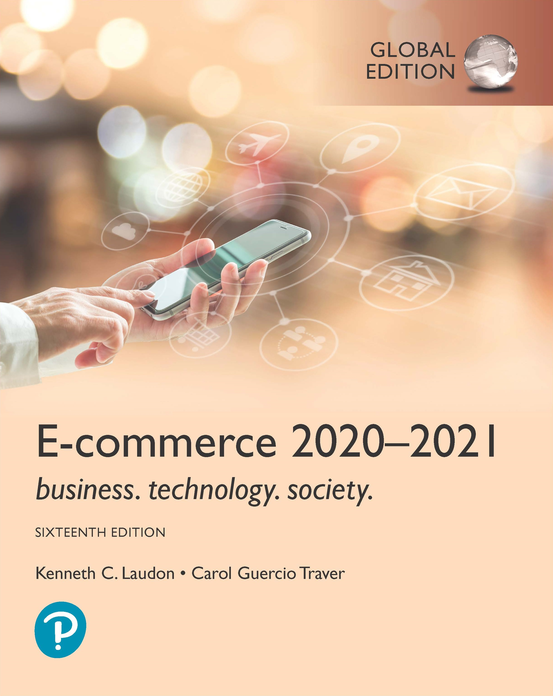
E-commerce 2020-2021: Business. Technology. Society.
Sixteenth Edition, Global Edition
Chapter 6
E-commerce Marketing and Advertising
Copyright © 2021 Pearson Education Ltd. All Rights Reserved
Notes:
If this PowerPoint presentation contains mathematical equations, you may need to check that your computer has the following installed:
1) MathType Plugin
2) Math Player (free versions available)
3) NVDA Reader (free versions available)

Slide 2
Learning Objectives
6.1 Understand the key features of the Internet audience, the basic concepts of consumer behavior and purchasing, and how consumers behave online.
6.2 Identify and describe the basic digital commerce marketing and advertising strategies and tools.
6.3 Identify and describe the main technologies that support online marketing.
6.4 Understand the costs and benefits of online marketing communications.

Slide 3
Consumers Online: The Internet Audience and Consumer Behavior (1 of 3)
Around 280 million in the U.S. have Internet access in 2018
In 2019, over 3.8 billion people of all ages had access to the Internet
Growth rate has slowed, especially in the U.S
Intensity and scope of use both increasing
Some demographic groups have much higher percentages of online usage
Income, education, age, ethnic dimensions

Slide 4
Consumers Online: The Internet Audience and Consumer Behavior (2 of 3)
Broadband and mobile
Significant inequalities in broadband access
Older adults, lower income, lower educational levels
Non-broadband household still accesses Internet via mobile or other locations
Community effects
Role of social emulation in consumption decisions
“Connectedness”
Top 10-15% are more independent and do not share purchases - iconoclasts
Middle 50% share more purchase patterns of friends – keeping with the Joneses
Recommender systems - co-purchase networks
Notes:
Social emulation is the idea where whenever individuals buy cultural products conspicuously, they do it in order to emulate or 'imitate' their superiors or those in the higher-class sections of the social hierarchy.
Amazon’s recommender systems (Customer who bought this item also bought …) create co-purchase networks where people do not know one another personally, but nevertheless triple the influence of complementary products.

Slide 5
Consumers Online: The Internet Audience and Consumer Behavior (3 of 3)
Consumer behavior models
Study of consumer behavior; social science discipline
Attempt to predict or explain wide range of consumer decisions
Based on background demographic factors and other intervening, more immediate variables
Profiles of online consumers
Consumers shop online primarily for convenience

Slide 6
Figure 6.1 A General Model of Consumer Behavior
Adapted from Kotler and Armstrong, Principles of Marketing, 13e, 2009, reprinted by permission of Pearson Education Ltd.
Notes:
Figure 6.1, Page 350.
Consumer behavior models try to predict the decisions that consumers make in the marketplace.
SOURCE: Adapted from Kotler and Armstrong, Principles of Marketing, 13e, 2009, reprinted by permission of Pearson Education, Inc.
Full description: An image depicts a general model of consumer behavior. Text illustrations from left to right depict a general model of consumer behavior that influences a consumer’s marketplace decisions. The image shows that independent demographic variables lead to intervening variables, which in turn lead to dependent variables. Independent demographic variables, also known as background factors, include Cultural, Social, and Psychological factors. Intervening variables, such as market stimuli, social networks, and communities, include Brand, Marketing Communications Stimuli, and Firm Capabilities. Dependent variables consist of In-store Behavior and Buyer Decisions

Slide 7
The Online Purchasing Decision (1 of 2)
Five stages in consumer decision process
Awareness of need
Search for more information
Evaluation of alternatives
Actual purchase decision
Post-purchase contact with firm

Slide 8
Figure 6.2 The Consumer Decision Process and Supporting Communications
Notes:
Figure 6.2, Page 351.
Full description: A figure depicts the consumer decision process and supporting communications. The consumer decision process and the types of offline and online marketing communications that support this process are shown as follows. The first step in the consumer decision process is awareness—need recognition. Online marketing communications that support awareness—need recognition include targeted display ads, targeted e-mail ads, and social media. Offline marketing communications that support awareness—need recognition include mass media, T V, radio, print media, and social networks. The second step in the consumer decision process is search. Online marketing communications that support search include search engines, online catalogs, site visits, targeted e-mail, and social networks. Offline marketing communications that support search include catalogs, print ads, mass media, salespeople, product raters, store visits and social networks. The third step in the consumer decision process is evaluation of alternatives. Online marketing communications that support evaluation of alternatives include search engines, online catalogs, site visits, product reviews, user evaluation, and social networks. Offline marketing communications that support evaluation of alternatives includes reference groups, opinion leaders, mass media, product raters, store visits, and social networks. The fourth step in the consumer decision process is purchase. Online marketing communications that support purchases include online promotions, discounts, targeted e-mail, and flash sales. Offline marketing communications that support purchases include promotions, direct mail, mass media, and print media. The fifth step in the consumer decision process is post-purchase behavior—loyalty. Online marketing communications that supports post-purchase behavior—loyalty include communities of consumption, newsletters, customer e-mail, online updates, and social networks. Offline marketing communications that supports post-purchase behavior—loyalty include warranties, service calls, parts and repair, consumer groups, and social networks.

Slide 9
The Online Purchasing Decision (2 of 2)
Decision process similar for online and offline behavior
General online behavior model
User characteristics
Product characteristics
Website features: latency, usability, security
Attitudes toward online purchasing
Perceptions about control over Web environment
Clickstream behavior
The transactional log that consumers establish as they move about the Web

Slide 10
Figure 6.3 A Model of Online Consumer Behavior
Notes:
Figure 6.3, Page 352.
In this general model of online consumer behavior, the decision to purchase is shaped by background demographic factors, several intervening factors, and, finally, influenced greatly by clickstream behavior very near to the precise moment of purchase.
Full description: A figure depicts a model of online consumer behavior. The user characteristics that influence online consumer behavior are as follows. Culture, Social Norms, Psychological Factors, and Background Demographic Factors. The intervening factors that influence online consumer behavior are as follows. Brand, Marketing Communications Stimuli, Firm Capabilities, Website and Mobile Platform Features, Consumer Skills, Product Characteristics, Purchasing Attitudes, Perceived Behavioral Control, and Social Networks. The decision to purchase is influenced greatly by clickstream Behavior very near to the purchase.

Slide 11
Shoppers: Browsers and Buyers
Shoppers: Over 90% of Internet users
Around 80% are buyers
Around 13% are browsers (purchase offline)
Online research influenced about $2.6 trillion of retail purchases in 2018
Online traffic also influenced by offline brands and shopping
E-commerce and traditional commerce are coupled: Part of a continuum of consuming behavior

Slide 12
What Consumers Shop for and Buy Online
Big ticket items ($1000 or more)
Travel, computer hardware, electronics
Consumers now more confident in purchasing costlier items
Small ticket items ($100 or less)
Apparel, books, office supplies, software, etc.
Sales of bulky goods, furniture and large appliances, rapidly expanding

Slide 13
How Consumers Shop
How shoppers find online vendors
Search engines
Marketplaces (Amazon, e Bay)
Specific retail site
About 8% of Internet users don’t shop online
Trust factor
Hassle factors (shipping costs, returns, etc.)

Slide 14
Trust, Utility, and Opportunism in Online Markets
Two most important factors shaping decision to purchase online:
Utility:
Better prices, convenience, speed
Trust:
Perception of credibility, ease of use, perceived risk
Sellers develop trust by building strong reputations for honesty, fairness, delivery

Slide 15
Digital Commerce Marketing and Advertising: Strategies and Tools
Features of Internet marketing (versus traditional)
More personalized
More participatory
More peer-to-peer
More communal
The most effective Internet marketing has all four features

Slide 16
Multi-Channel Marketing Plan
Website
Traditional online marketing
Search engine, display, e-mail, affiliate
Social marketing
Social networks, blogs, video, game
Mobile marketing
Mobile/tablet sites, apps
Offline marketing
Television, radio, newspapers

Slide 17
Establishing the Customer Relationship
Website functions to:
Establish brand identity and customer expectations
Differentiating product
Anchor the brand online
Central point for all marketing messages
Inform and educate customer
Shape customer experience

Slide 18
Online Marketing and Advertising
Online advertising
Display, search, mobile messaging, sponsorships, classifieds, lead generation, e-mail
Advantages:
18-34 audience is online
Ad targeting to individuals
Price discrimination
Personalization

Slide 19
Traditional Online Marketing and Advertising Tools
Search engine marketing and advertising
Display ad marketing
E-mail marketing
Affiliate marketing
Viral marketing
Lead generation marketing
Notes:
Search engine marketing: involves the use of search engines to build and sustain brands
Search engine advertising: involves the use of search engines to support direct sales online.
Organic search: inclusion and ranking of sites depends on a more or less unbiased application of a set of rules imposed by the search engine
Affiliate marketing is the process by which an affiliate earns a commission for marketing another person's or company's products. The affiliate simply searches for a product they enjoy, then promotes that product and earns a piece of the profit from each sale they make.
Viral marketing is a style of promotion that relies on an audience to generate the message of a product or service. Marketing is considered “viral” when it reaches the point where it's being shared by the public at large rather than just its target audience.
Lead generation, the marketing process of stimulating and capturing interest in a product or service for the purpose of developing a sales pipeline, allows companies to nurture targets until they're ready to buy.

Slide 20
Search Engine Marketing and Advertising (1 of 2)
Search engine marketing (S E M)
Use of search engines for branding
Search engine advertising
Use of search engines to support direct sales
Types of search engine advertising
Paid inclusion
Pay-per-click (P P C) search ads
Keyword advertising
Network keyword advertising (context advertising)
Notes:
Keyword advertising: Merchants purchase keywords through a bidding process at search sites, and whenever a consumer searches for that word, their advertisement shows up somewhere on the page.
Network keyword advertising: introduced by Google as its AdSense product in 2002. Publishers join these networks and allow the search engine to place “relevant” ads on their sites

Slide 21
Search Engine Marketing and Advertising (2 of 2)
Search engine optimization (S E O)
Google search engine algorithms
Social search
Utilizes social contacts and social graph to provide fewer and more relevant results
Search engine issues
Paid inclusion and placement practices
Link farms, content farms
Click fraud
Notes:
SEO – techniques to improve the ranking of web pages generated by search engine algorithms.
A link farm is a group of websites that all link to the other websites in the group to increase rankings in the search results (SERPs). This technique is a black-hat technique, which means that it is considered a manipulative technique. It is also considered a form of spam and sites which search engines like Google determine to be involved in link farms are penalised for it.
A content farm is a website that produces a large amount of low-quality articles on many different topics, then uses keywords so that they are placed highly on Google or other search engine results.
Click fraud is the act of clicking on a paid link, such as display ad or sponsored search result, with malicious or vindictive intent.

Slide 22
Display Ad Marketing (1 of 2)
Banner ads
Rich media ads
Interstitial ads
Video ads
Far more effective than other display formats
Sponsorships
Native advertising
Notes:
Interstitial ads are full-screen ads that cover the interface of their host app. They're typically displayed at natural transition points in the flow of an app, such as between activities or during the pause between levels in a game.
Native advertising is the use of paid ads that fit seamlessly into the media where they appear. They blend in to match the content so that they don’t disrupt the viewer’s experience. In this way, advertisers can post content that hooks viewers’ attention by not being an obvious ad.

Slide 23
Display Ad Marketing (2 of 2)
Content marketing
Advertising networks
Ad exchanges, programmatic advertising, and real-time bidding (R T B)
Display advertising issues
Ad fraud
Viewability
Ad blocking
Notes:
Content marketing is a marketing strategy used to attract, engage, and retain an audience by creating and sharing relevant articles, videos, podcasts, and other media. This approach establishes expertise, promotes brand awareness, and keeps your business top of mind when it's time to buy what you sell.
An online advertising network or ad network is a company that connects advertisers to websites that want to host advertisements.
Ad fraud is a type of scam in which the perpetrator fools advertisers into paying for something that is worthless to them, such as fake traffic, fake leads or misrepresented and ineffective ad placement.

Slide 24
Figure 6.6 How an Advertising Network Works
Notes:
Figure 6.6, Page 369.
Millions of publishers have audiences to sell, and pages to fill with ads. Thousands of advertisers are looking for audiences. Ad networks are intermediaries that connect publishers with marketers.
Full description: A model illustrates how an advertising network works. 1. Consumer requests web page from ad network member merchant site. 2. Merchant site’s merchant server connects to the ad network ad server. The ad network’s ad server connects with its user profile database. 3. Ad server reads cookie and checks database for the consumer’s user profile. 4. Ad server selects and serves user an appropriate display ad based on the consumer’s user profile. 5. The ad network follows consumer from site to site through use of tracking files.

Slide 25
E-mail Marketing
Direct e-mail marketing
Messages sent directly to interested users
Benefits include
Inexpensive
Average around 3% to 4% click-throughs
Measuring and tracking responses
Personalization and targeting
Three main challenges
Spam
Anti-spam software
Poorly targeted purchased e-mail lists

Slide 26
Spam
Unsolicited commercial e-mail
Around 55% of all e-mail in 2018
Most originates from bot networks
Efforts to control spam have largely failed:
Government regulation (C A N - S P A M)
State laws
Voluntary self-regulation by industries (D M A)
Canada’s stringent anti-spam laws
Notes:
Controlling the Assault of Non-Solicited Pornography and Marketing Act (CAN-SPAM Act)
Digital Markets Act (DMA) - European Union

Slide 27
Other Types of Traditional Online Marketing
Affiliate marketing
Commission fee paid to other websites for sending customers to their website
Viral marketing
Marketing designed to inspire customers to pass message to others
Lead generation marketing
Services and tools for collecting, managing, and converting leads

Slide 28
Social, Mobile, and Local Marketing and Advertising
Social marketing and advertising
Use of online social networks and communities
Mobile marketing and advertising
Use of mobile platform
Influence of mobile apps
Local marketing
Geotargeting
Display ads in hyperlocal publications
Coupons
Notes:
Hyperlocal marketing focuses on targeting prospective customers within a restricted local area. This “local area” is usually a few blocks or streets around your business. The main goal is to increase foot traffic to a store's physical location by targeting people who conduct “near me” searches on their mobile devices

Slide 29
Multi-Channel Marketing
Integration of online and offline marketing
Increasing percentage of American media consumers use several media at once
Reinforce branding messages across media
Most effective multi-channel campaigns use consistent imagery across media

Slide 30
Other Online Marketing Strategies
Customer retention strategies
One-to-one marketing (personalization)
Behavioral targeting (interest-based advertising)
Retargeting
Customization and customer co-production
Customer service
F A Qs
Real-time customer service chat systems
Automated response systems

Slide 31
Pricing Strategies (1 of 2)
Pricing: integral part of marketing strategy
Traditional pricing based on fixed costs, variable costs, demand curve
Marginal costs
Marginal revenue
Piggyback strategy
Price discrimination
Notes:
Marginal cost refers to the increase or decrease in the cost of producing one more unit or serving one more customer. It is also known as incremental cost.
Piggyback marketing is a marketing strategy where two firms collaborate and represent each other's complementary products in a competitive market rather than competing with each other. Piggyback is a cost-effective strategy as both partners represent each other in their respective markets.

Slide 32
Pricing Strategies (2 of 2)
Free and freemium
Versioning
Bundling
Dynamic pricing
Auctions
Yield management
Surge pricing
Flash marketing
Notes:
Versioning means you develop a lowest-cost base price model that captures your most price sensitive customers while ensuring tolerable margins. The twist is you then offer better-featured versions of your product at higher prices (and margins) for less price sensitive customers.
Yield management is a dynamic hotel pricing strategy designed to produce the maximum revenue, or yield, from a set inventory of rooms. It's about understanding and influencing traveler booking behavior and finding the optimal balance between occupancy and rate
Dynamic pricing, also referred to as surge pricing, demand pricing, or time-based pricing, is a pricing strategy in which businesses set flexible prices for products or services based on current market demands.
A flash sale also called a deal of the day, is a sale with a big discount that can reach up to 80% on particular items and is only valid for a short period, usually for 24-36 hours

Slide 33
Long Tail Marketing
Internet allows for sales of obscure products with little demand
Substantial revenue because
Near zero inventory costs
Little marketing costs
Search and recommendation engines
Notes:
What is long tail marketing? Long tail marketing is the strategy of selling large amounts of popular products in addition to low amounts of niche products or services in niche markets. T

Slide 34
Internet Marketing Technologies
Internet’s main impacts on marketing:
Scope of marketing communications broadened
Richness of marketing communications increased
Information intensity of marketplace expanded
Always-on mobile environment expands marketing opportunities

Slide 35
Web Transaction Logs
Built into web server software
Record user activity at website
Provides much marketing data, especially combined with:
Registration forms
Shopping cart database
Answers questions such as:
What are major patterns of interest and purchase?
After home page, where do users go first? Second?

Slide 36
Cookies and Tracking Files
Types of tracking files
Cookies
Flash cookies
Web beacons (“bugs”)
Tracking headers (supercookies)
Other tracking methods
Deterministic cross-device tracking
Probabilistic cross-device tracking
Notes:
Any platform or publisher that collects email addresses or requires users to sign in on their devices can use deterministic tracking for ad targeting. Probabilistic tracking relies on identifiers that use models and algorithms to match a user's devices.

Slide 37
Databases
Enable profiling
Store records and attributes
Database management system (D B M S):
S Q L (Structured Query Language):
Industry-standard database query and manipulation language used in a relational database
Relational databases

Slide 38
Data Warehouses and Data Mining
Data warehouse:
Collects firm’s transactional and customer data in single location for offline analysis by marketers and site managers
Data mining:
Analytical techniques to find patterns in data, model behavior of customers, develop customer profiles
Query-driven data mining
Model-driven data mining
Rule-based data mining

Slide 39
Hadoop and the Challenge of Big Data
Big data
Petabyte, exabyte range
Web traffic, e-mail, social media, content
Traditional D B M S unable to process the increasing volume of data
Hadoop
Open-source software framework
Processes any type of data, even unstructured
Distributed processing

Slide 40
Marketing Automation and Customer Relationship Management (C R M) Systems
Marketing automation systems
Track steps in lead generation
C R M systems
Manage relationship with customers once purchase is made
Create customer profiles
Customer data used to:
Develop and sell additional products
Identify profitable customers
Optimize service delivery, and so on

Slide 41
Figure 6.9 A Customer Relationship Management System
Notes:
Figure 6.9, Page 403.
This is an example of a CRM system. The system captures customer information from all customer touchpoints as well as other data sources, merges the data, and aggregates it into a single customer data repository or data warehouse where it can be used to provide better service, as well as to construct customer profiles for marketing purposes. Online analytical processing (OLAP) allows managers to dynamically analyze customer activities to spot trends or problems involving customers. Other analytical software programs analyze aggregate customer behavior to identify profitable and unprofitable customers as well as customer activities.
Full description: An image depicts a customer relationship management system. In the lower part of the image, customer touch points are shown as follows. Telephone, Sales force, Website, In-store, Social networks, and Mail. These customer touch points direct toward the following functions: 1. Transaction processing and operational data collection. 2. Data aggregation, data cleaning, customer database, and data warehouse. 3. Business intelligence, data mining, analysis and reporting, and modeling. 4. Marketing campaign management, advertising campaign management, and behavioral targeting.

Slide 42
Online Marketing Metrics: Lexicon
Audience size/market share metrics
Impressions, click-through rate (C T R), page views, viewability rate, stickiness, loyalty, reach, recency
Conversion to customer metrics
Acquisition rate, conversion rate, browse-to-buy ratio, cart conversion rate, abandonment rate
Video ad metrics
View time, completion rate
E-mail campaign metrics
Open rate, delivery rate, click-through rate, bounce-back rate

Slide 43
Figure 6.10 An Online Consumer Purchasing Model
Notes:
Figure 6.10, Page 407.
The conversion of visitors into customers, and then loyal customers, is a complex and long-term process that may take several months.
Full description: The figure shows an online consumer purchasing model. Starting from the left is the following. Awareness-need recognition, which involves Market Communications. Examples of market communications include Search engine, Display ads, E-mail, Affiliates, Social networks, Blogs, Mobile ads, and Apps. The example assumes 100,000 Impressions, 10,000 Search clicks, and 1,500 Likes. Next is Search, which involves Website hits. This generates 1,000 Unique visitors, or 1 percent of the impressions. Next is Evaluation of Alternatives, which involves Page views, Stickiness, and Site design. Next is Purchase, which involves Acquisition and Conversion. This generates 50 Purchases, or 5 percent rate. Lastly is Post-purchase behavior or loyalty, which generates 12 loyal customers, or 25 percent retention.

Slide 44
How Well Does Online Advertising Work?
Use R O I to measure ad campaign
Difficulty of cross-platform attribution
Highest click-through rates: Search engine ads, permission e-mail campaigns
Online channels compare favorably with traditional
Most powerful marketing campaigns use multiple channels, including online, catalog, T V, radio, newspapers, stores

Slide 45
The Costs of Online Advertising
Pricing models
Barter, cost per thousand (C P M), cost per click (C P C), cost per action (C P A), hybrid, sponsorship
Measuring issues
Correlating online marketing to online or offline sales
In general, online marketing is more expensive on C P M basis, but more efficient in producing sales
Effective cost-per-thousand (e C P M)

Slide 46
Marketing Analytics
Software that analyzes data at each stage of the customer conversion process
Awareness
Engagement
Interaction
Purchase activity
Loyalty and post-purchase
Helps managers
Optimize R O I on website and marketing efforts
Build detailed customer profiles
Measure impact of marketing campaigns

Slide 47
Figure 6.11 Marketing Analytics and the Online Purchasing Process
Notes:
Figure 6.11, Page 412.
Marketing analytics help e-commerce firms to better understand consumer behavior at each stage of the online purchasing process.
Full description: An image depicts marketing analytics and the online purchasing process model. The figure, from left to right, shows the following process. Awareness In-bound involves Unique visitors. Engagement involves Page views, Duration, and Content views. Interaction involves Posts, Likes, Pins and tweets, and Comments. Purchase involves Enter cart page, Register, Purchase, Abandon. Post-purchase service loyalty involves Repeat customers, Social site buzz, and Service requests.

Slide 48
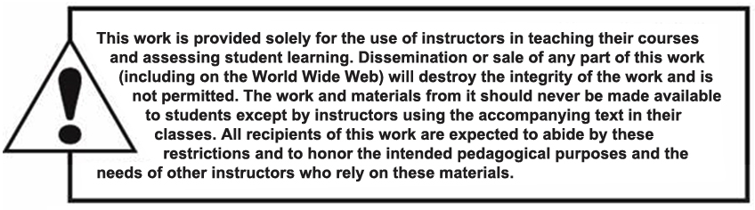
Copyright

